Slide 1


Economy: 6 pillars + theory + current + BES17 (pre cum Mains)
1.Banking, Fin, Insur.
6.HRD
2.Budget
3.BoP
4.Sectors
5.Infra
V1:c3,4
V1:c2,3, 6,9,11(GST),13
V1c:5
V1c:7(Textile),11(trade)
V1c:10
v1c:12, 14; Budget^Rail

Slide 2


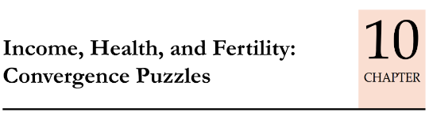
UNDP HDR-2016: [March 2017]
HDI (0-1)
HDI-inequality adj. (IHDI)
Gender Dev. (GDI)
Poverty Multidim. (MPI)
Gender Inequality (GII)
Health, Education, PH, Tribal related schemes
Schemes for Women
Poverty, Hunger schemes
Notes:
Human Development Index (HDI)
the Inequality-Adjusted Human Development Index (IHDI)
Gender Development Index (GDI)
Gender Inequality Index (GII)
Multidimensional Poverty Index (MPI)

Slide 3
1944: Brettonwoods, USA: 1) IMF 2) World Bank 3) GATT->WTO. 1945: San Francisco Conference : United Nations
6 Principal Organs
Security Council [P5]
ECOSOC Council
Trusteeship
Intl. territories, Inactive.
Intl. court of Justice
Secretariat, NY, USA
General Assembly [193]
SC: selects UN Secretary General
GA: Appoints, 5 years. [Informally: 2 terms, regional rotation]
Portugal’s ex-PM Antonio Guterres replaced Ban Ki Moon (S.Korea) as ninth UN secretary general from 1/1/2017. no woman so far. Fn in this article
ICJ, UN
Between nations; “world court”
ICC, Not UN
Individual criminals of War, genocide
Rome Statute’98-’02
Kulbhushan Jadhav case here
Both sit @ Hague, Netherlands

Slide 4
Mock Question for Prelims
Consider following statement
International court of justice (ICJ) was setup under the Rome Statute of UN.
India won Kulbhushan Jadhav case against Pakistan, in International criminal court (ICC)
Both ICJ and ICC are located at the Hague of Netherlands.
Answer choices:
a) Only 1 and 2 (b) Only 2 and 3
c) Only 1 and 3 (d) all of them

Slide 5
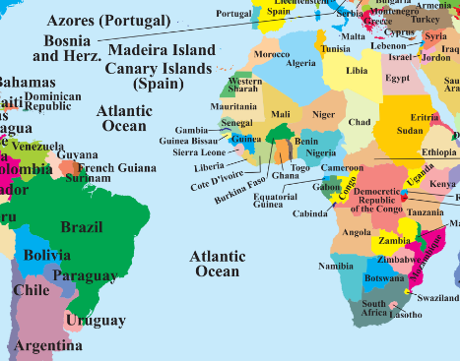
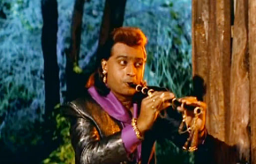
UN → Economic and Social Council (ECOSOC)→ 7 Agencies
The United Nations Environment Programme (UNEP), Nairobi, Kenya
7 specialized Agencies
UNFCCC is not ‘under’ UNEP. Separate treaty from ‘92’s Rio Earth Summit.
Kyoto, Paris…
The United Nations International Children’s Emergency Fund (UNICEF)
The United Nations High Commissioner for Refugees (UNCR)
The United Nations Conference on Trade and Development (UNCTAD)
The United Nations Industrial Development Organization (UNIDO)
United Nations Development Programme (UNDP), NY
Human development Report
World Food Programme
NOT Global Hunger report. That’s IFPRI
WTO 2017
Both UNEP HQ &
Tapasvi Gunjal’s Casino are located @Kenya’s Nairobi.

Slide 6

Released on March 2017.
S.Asia
Male >Female +20pt
Nepal
Brahmin > Dalit
Everywhere
Elites & Religious & Ethnic Majority >> others
Climate Change
Present Generation >> Future Gen (SDG)
1990, Mahbub ul Haq (Pak), Amartya Sen (India)
Theme-2015: “WORK for Human development”

Slide 7

HOW TO FIX THEN? Ans. “4 pronged policies”
Universal Policies
Healthcare: “Geographically”?
PH special provisions
“Affirmative” Policies
Disaster, war, ISIS extremism, Zika Epidemic? ☹
Atrocity prevention
More bol-bacchan in Mains
Empowering Policies
Resilient Policies
Civil rights promotion

Slide 8
UNDP HDR-2016: 5 indexes
HDI (0-1)
HDI-inequality adj. (IHDI)
Gender Dev. (GDI)
Poverty Multidim. (MPI)
Gender Inequality (GII)
Health, Education, PH, Tribal related
Schemes for Women
Poverty, Hunger schemes
Notes:
Human Development Index (HDI)
the Inequality-Adjusted Human Development Index (IHDI)
Gender Development Index (GDI)
Gender Inequality Index (GII)
Multidimensional Poverty Index (MPI)

Slide 9


Index #1: Human Development Index (HDI)
Paidaa Hotaa
Padhtaa
Paise Kamata
to live a long and healthy life
to be educated and knowledgeable
to enjoy a decent economic standard of living.

Slide 10


National Health Policy: 2002 2017, March
IMR: Infant mortality Rate = death before 1st birthday / 1000 live births.
Maternal Mortality Rate: within 42 days of delivery / 1 lakh live birth
100 by 2018-20
28 by 2019
Premature mortality (CVD, Cancer, Diabetes etc)
25% down by 2025
90-90-90 By 2020
Under five mortality
23 by 2025
HIV (global target of UNAIDS)
Life expectancy @birth
70 by 2025
Present~ 168 ☹
Red boxes mentioned in Budget 2017 (Feb) as well.

Slide 11

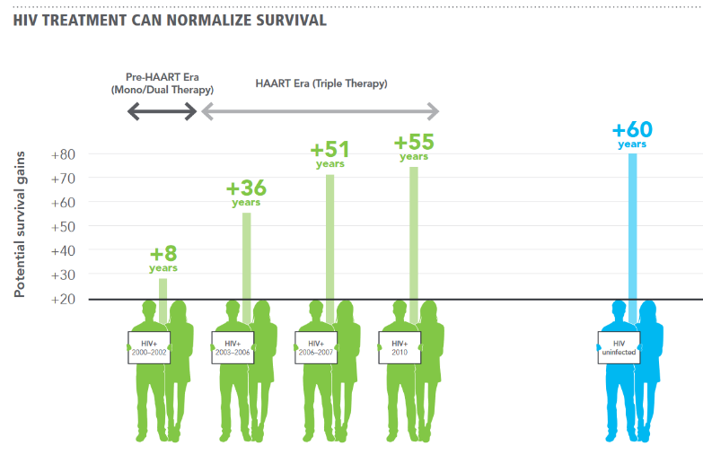
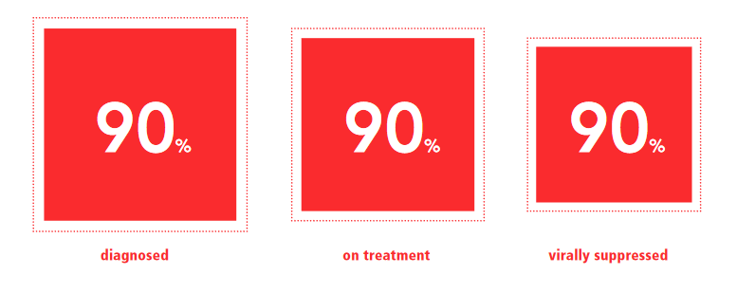
UN AIDS program (Geneva, Switzerland – co location with WHO)
2020 goal
Also in our health policy
Virally suppressed meaning
“CURED”..x Daily ART drugs yes
But Virus count controlled- transmission chance reduced,
Can do normal work..bed-ridden

Slide 12
Mock Question for Prelims
What is the objective of UN AIDS program’s 90-90-90 target?
90% reduction in the new HIV cases
90% improvement in the life expectancy of the HIV positive patient.
90% of the HIV patients on treatment should become virally suppressed.
All of the above.

Slide 13




National Health policy 2017
FREE
$? 2.5% of GDP
Centres
Surveillance
Drugs, diagnosis, treatment
PHC: “wellness” (2/3rd of $)
District: secondary treatment
2020: disease registry
Digital healthcare network: National Digital Health Authority (NDHA) [google drive for Xray, CT scan]
Bolbchchan
medical device pricing ▼Make In India, Generic drugs,
More in Mains
AYUNASH+Yoga

Slide 14
Pregnant women: Health Ministry
PM Suraksheet Matritwa Yojana'2016
ante-natal checkup for pregnant women on ninth of every month by a specialist.
use private doctors if sarkaari not available
Janani Suraksha + Shishu Suraksha
Suraksha Yojana'05: encourage institutional delivery, To reduce MMR
Janani Shishu Suraksha Karyakram (JSSK)'11: free delivery @Government hospital, free Caesarean delivery + child upto 1 year. +drug, diet, transport (102 ambulance)
ASHA→ Iron folic tables, vaccines, future family planning.
Nowadays MCQs coming from Modi schemes only. So let’s ignore the past
PMSMY using that JSSK funding only!!
Mother
Grow up?
New born
Notes:
http://www.nrhmhp.gov.in/sites/default/files/files/PMSMA-Guidelines.pdf
Janani Suraksha Yojana'05
Health Min.
encourage institutional delivery
To, reduce MMR (174 / 1 lakh live births)
Janani Shishu Suraksha Karyakram (JSSK)'11, Jan
Health Min.
free delivery @Government hospital
free Caesarean delivery
+ child upto 1 year.
+drug, diet, transport (102 ambulance)
PM Surakshit Matritwa Yojana'2016
Health Min.
ante-natal checkup for pregnant women on ninth of every month by a specialist.
use private doctors if sarkaari not available

Slide 15
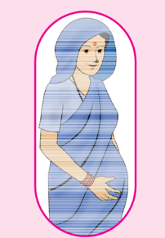
Ministry of women, child development
Maternity
Rajiv Gandhi National Creche Scheme for the Children of Working Mothers. [शिशु गृह]
2010: Indira Gandhi Pradhan Mantri Matritva Sahyog Yojana: Conditional cash transfer for wage loss. [med checkup, clinic delivery, vaccination]
2013: NFSA [6k to pregnant and lactating women]
2015: IG tweaked to implement NFSA. 4k given, and only in 53 districts.
Post-Dem: Modi announced 6k to all mothers for hospital admission, vaccination and nutritional food.
Budget 2017: MWCD given Rs.2700 cr.
>19 old mother only, and for first two children only. 60-40|90-10 [Core Scheme]
Critiques: not sufficient ☹ need 16k cr. Allotment.
Mother
Grow up?
New born
Notes:
http://wcd.nic.in/schemes/revision-under-igmsy-accordance-national-food-security-act-2013-xiith-plan
http://wcd.nic.in/sites/default/files/IGMSYscheme.pdf

Slide 16
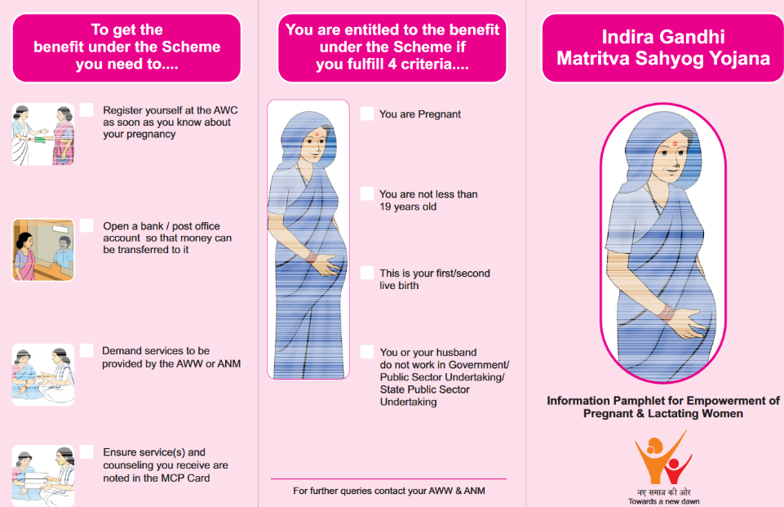
PRADHAN MANTRI

Slide 17
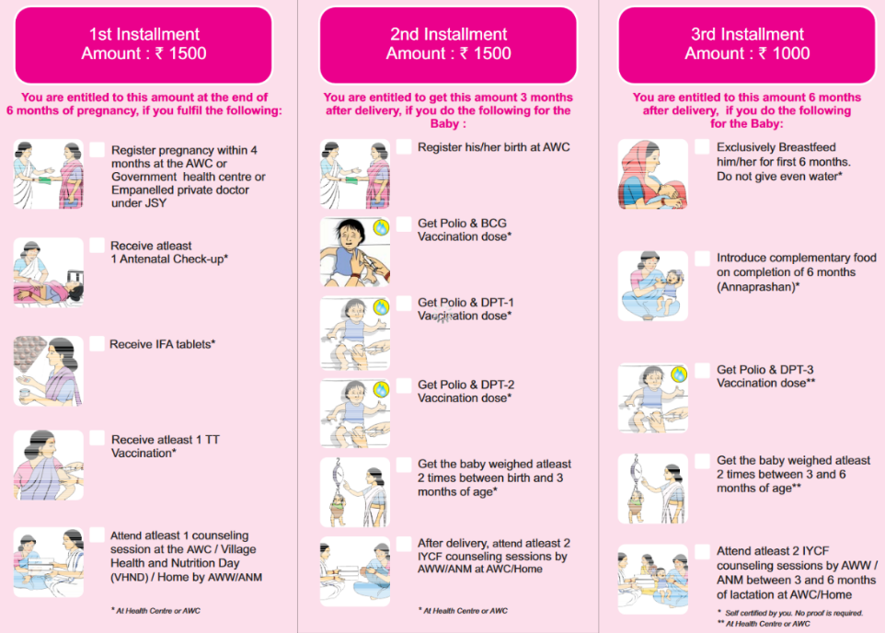
Anemia, low birthweight
Vaccination
Benefit: ~40% births done in hospitals. Scheme→ MMR, IMR, malnutrition & diseases can be reduced.

Slide 18

Indradhanush by Health Ministry
Vaccination
1985: Universal Immunisation Programme (U.I.P.)
Indradhanush: 2014 to 2020
Full and free Vaccination- children and Preg. Women (Tetanus)
Seven diseases: diphtheria, whooping cough, tetanus, polio, tuberculosis, measles, and Hep.B.
Selected states: Jap.encp., Influenza type-B
2016 update: 4 new to be added
Rotavirus [diarrhoea]
inactivated polio vaccine biavalent [WHO: rare polio ]
Japanese Encephalitis for adults
measles rubella <NEXT SLIDE>
Mother
Grow up?
New born
Notes:
May 30 () Health Ministry's ambitious programme 'Mission Indradhanush', which provides immunisation against seven life threatening diseases, is all set to be re-christened as the addition of four new vaccines into its basket.

Slide 19
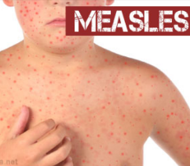
2017, Feb MR Measles Rubella campaign
Vaccination
By, Health Ministry
Single vaccine for two disease
Target kids: 9 months to <15 years.
Measles: viral fever + skin rash.
Rubella: “German Measles”
Mild infection. But in pregnant women, it can cause CRS (congenital rubella syndrome)→ kids with eye,ear,heart defects.
So prevent ‘future’ generation from this.
Mother
Grow up?
New born
Notes:
May 30 () Health Ministry's ambitious programme 'Mission Indradhanush', which provides immunisation against seven life threatening diseases, is all set to be re-christened as the addition of four new vaccines into its basket.

Slide 20
Mock Question for Prelims
The salient feature(s) of Pradhan Mantri Matritva Sahyog Yojana is / are:
Provide Rs.6,000/- direct benefit transfer to all the pregnant women of India, irrespective of income or occupation status.
Pregnant woman will be checked by a specialist, on 9th of every month.
Pregnant women will be given IFA tablets, Measles Rubella vaccine and tetanus vaccine.
None of the above.

Slide 21
Infants and children: Only MODI schemes we focus
Rashtriya ___ Karyakram
India Newborn Action Plan (INAP): 2014, Sept.
Single digit Neonatal MR by 2030
Reproductive, Maternal, Newborn, Child and Adolescent health (RMNCH+A)
2013: Bal Swasthya Karyakram: for disease detection, disability
2014, Jan: Kishor Swasthya Karyakram: 25 cr. adolescent , life skill, sexual health, addiction
Neonatal MR: 1st 28 days / 1000 live birth.
Mother
Grow up?
New born

Slide 22
These two health schemes are “Core Schemes”- 60-40| 90-10
National Health Mission (NHM) 27k cr in Budget 2017 [majority for Rural]
Rural (NRHM)
Urban Health Mission (NUHM)
Pop >50k (IYB)
ASHA workers...yes (since 2013)
To spend 2.5% of GDP [Inflation not adjusted]
Rs. 4,200 lakh cr!!
PPP + State Govt.
Jt. Program for Non-Communicable Diseases (NCDs)- heart, diabetes, cancer
Health
Ministry
AYU(Na)SH Min. (Formed in 2014)
Tibetan: Sowa rigpa latest
21st June: Intl. Yoga Day by UNGA
AYUSH drugs as such fall under D&C Act ‘40
Mother
Grow up?
New born
Notes:
Accredited Social Health Activists (ASHAs)

Slide 23
Women, health, children
Wellness centre<- 1.5 lakh PHC
Mahila Shakti Kendra @ICDS Anganwadis: one stop- vocation (Skill), vaccination to violence
Preg. Women: 6k DBT IF institutionalized delivery and vaccination
Budget 2017
2015: SAKHI one stop centre <-Nirbhaya fund
Action plan to eliminate
2017
Kala Azar
Filariasis
2018
Leprosy
2020
Measles
2025
TB
HW: lucent GK/ GS Manual: which is caused by what?

Slide 24
Medical Higher education?
▲5k new P.G. seats / per year
2 new AIIMS @Jharkhand and Gujarat
DNB courses (Post-MBBS Diploma in National Board, under health ministry) - these DNB courses will be rolled out in more hospitals both public and private.
Amend D&C Act for cheap drugs
Budget 2017

Slide 25

PM Jan Aushadhi Pariyojana
Cheap drugs
Chemical and Fertilizer ministry→ Dept of pharmaceuticals
~850 shops across India. “Jan Aushadhi Kendra”
State has to give free space in District hospital. NGO, agency, individual can run shop.
BPPI (Bureau of Pharma Public Sector Undertakings of India)→ supply Generic drugs to Jan Aushadhi Kendra

Slide 26
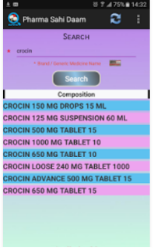
NPPA
Drug price control
1955: Essential Commodities Act’ → Drug Price Control Order (DPCO) ’95
1997: National Pharmaceutical Pricing Authority (NPPA) under Dept of Pharma under Min. of Chemical & Fertilizer. Executive body, no act.
If anyone overcharging money on drugs, NPPA can recover with 15% interest, under DPCO.
App: Pharma SAHI DAAM [गलत दाम]
Portal: Pharma Jan Samadhan for grievances
-----
2011: National List of Essential Medicines, (NLEM) by Health Ministry
2012: National Pharmaceutical Pricing Policy for Market-Based Pricing (MBP) [Ceiling prices are fixed by NPPA].
PM Jan Aushadi = PSU “generic” cheap drugs @govt shop, but
what about pvt companies → private medical store are looting @higher price?

Slide 27
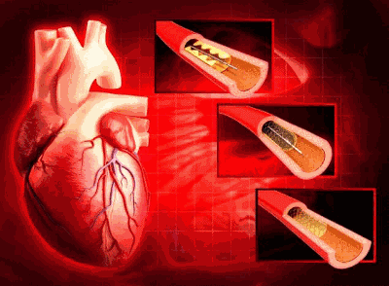
Stent issue?
Coronary stent is a tube-shaped device placed in the arteries [धमनियों] that supply blood to the heart. 2 types, private hospitals were doing loot bazaar.
Stent was added in National List of Essential Medicines= NPPA can fix maximum prices.
But hospitals started charging extra for ‘surgery’. [just like highways are downgraded to “Local Roads” after SC Liquor ban.] hence our HDI rank is 131st because very short term vision and selfishness.

Slide 28

Index #1: Human Development Index (HDI) for 2016
Paidaa Hotaa
Padhtaa
Paise Kamata
to live a long and healthy life
to be educated and knowledgeable
to enjoy a decent economic standard of living.
Life expectancy @Birth
68.3 years

Slide 29
Education: HRD Ministry: “CORE SCHEMES” (60-40-90-10)
86th Amendment Act 2002
Adhar compulsory
MDM (Rs. 10k cr) | Dept of School Education
Food, ration (class 1 to 8) in Govt school, Madresa, Maqtab
2015: Subcomponent: Padhe Bharat Badhe Bharat (SSA): Improve learning outcomes, Maths, reading- extra classes @class1 and 2.
SSA (2001)- Budget’17: 23500 cr.
implement RTE (hard, soft infra)
Free-compulsory education for 6-14. [FR: 21a + FD: 51A];
But Javdekar: Exam @5 & @8, after second attempt then “FAIL” [optional, 2018;] Delhi, Rajasthan already amended but HRD says, central act we’ll amend.
“No detention” till class8. [actually CCE, but all ‘passed’]
RTE Act 2009: 25% to EWS in public |Private schools but not MINORITY inst.
Notes:
http://pib.nic.in/newsite/PrintRelease.aspx?relid=159006
SSA was even before RTE.
Continuous and Comprehensive Evaluation

Slide 30
Education: HRD Ministry: “CORE SCHEMES” (60409010)
Ok class 1 to 8 finished then..Higher Education
RMSA: Madhyamik [higher secondary schools] 2020 [3830 cr.]
RUSA: Ucchatar (new college univ) [1300 cr.]
Teachers and Adults [925 cr.]
Pt. Madan Mohan Malviya Training program (budget 2014)
Sakshar Bharat: adult literacy [प्रौढ़ साक्षरता]
(Draft) New Education Policy 2016
T.S.R. Subramanian Committee → inputs sought from Juntaa.
Now Javdekar says, will launch by December 2017 ☺
Although for mains- TSR’s draft policy, lecture link
Rural women education: Mahila Samakhya ’89

Slide 31
Education: ICT, E-governance, Distance learning?
Nehruvian economy “Inspector raj; MODI =App Portal-raj
CLICK: online virtual classes (budget 2014)
SWAYAM: MOOC [HRD]; Sugamya Pustakalaya- [VH library by PH Dept]
New Agencies in HRD ministry?
2016: Higher Education Finance Agency (HEFA)- infra upgrade of higher edu. [’17: 250 cr.] total 1k cr. it has to mobilize
PM Vidhya Laxmi Karyakram: scholarship, loan (2015)
2017: National Testing Agency: take over CBSE's exams like 1) JEE 2) JRF - NET 23) NEET 4) CTET
2017: SHAGUN (Shala+Gunvatta) web portal: monitoring SSA by HRD
2017, June: new testing agency may be called “Higher Education Empowerment Regulation Agency (HEERA)“
2017 (to be): National Academic Depository (NAD)- “google drive” for mark sheets, so no physical copies / fake degree problem.
Although Digilocker already in Electronics Ministry for all public docx.
Recall: BHIM-NPCi, MADAD-MEA, Urja Mittra & Garv-II (Power Min) ; Pharma SAHI Daam (NPPA)
Notes:
Like driving card, adhar license.

Slide 32
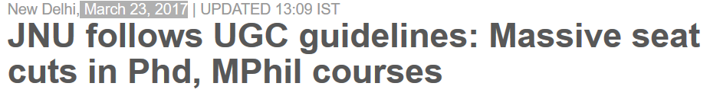
Statutory bodies for higher education
Exact years not important.
both are statutory. But UGC is ‘bigger org’
“NAAC” accreditation: UGC
National institutional ranking framework: HRD
If FinMin didn’t do “Hushiyaari” against RBI Governor, then MUDRA large spread !?
If JNU didn’t do Anti-Modi sloganeering, then UGC would have tightened?!
Lesson: one shd not do ‘hushiyaari’ in front of those with administrative power. (GSM4)

Slide 33
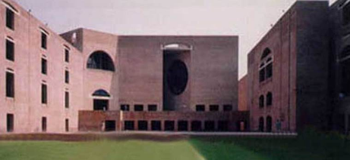
IIM bill 2017 and autonomy?
Who can give bachelor, PG & Ph.D degrees?
Ans. UGC recognized…
Private University
Deemed-to-be-a-University
Institute of National Importance
IIT, AIIMS, NIT
Central & State University
But 20 IIMs are ‘registered societies’.
So PG Diploma & Fellow certificates. IIM Bill 2017 puts them here…so they can award degree (+ many other features)

Slide 34
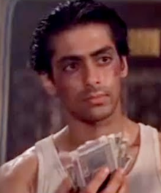

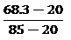
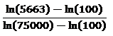


Paidaa Hotaa
Padhtaa
Paise Kamata
Expected years of schooling: 11.7
Life expectancy @Birth
68.3 years
GNI per capita (PPP-2011)
$5663
Mean years of schooling: 6.3
$Edu. index: = \left(\frac{11.7/18+6.3/15}{2}\right)=0$.535
$$HDI=\sqrt[3]{life index ∗Edu. index ∗income index} \\ = \sqrt[3]{0.74∗0.535∗0.609} ;geometric mean \\ =0.624 for India$$
Notes:
natural logarithm

Slide 35
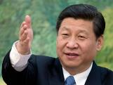
UNDP 2016 report: Human Development index (0-1)
Very high (0.800 to <1)
1) Norway 2) Aus 3) Switzerland …… 10) US 18) UK 49) Russia
Low Development (<0.550)
Medium (0.550 to <0.700)
131: India (last year 130) [ Bhutan, Bangladesh, Nepal, Myanmar, Pak are behind us!! ☺- in happiness index, they were ahead.. इधर “हरा” दिया.]
188th : Central African Republic (MOST BOGUS: hunger, happiness, HD)
119: S. Africa ☹ [but they have highest HIV population in world, still ahead of India!]
High (0.700 to <0.800)
90) China ☹ [@हिन्दुस्तानियो, Human Development हमसे सीखो- 11th JingPing]
79) Brazil ☹ [so corrupt even president Dilma Rousseff was impeached]
India most bogus among BRICS

Slide 36
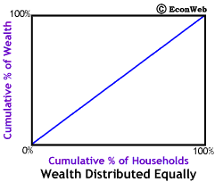
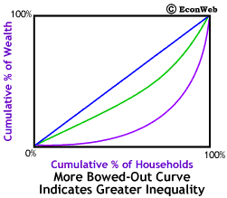
HDI: Rus> India > CAR. But possible Lutyens' Delhi>> Russia parts of MP, Odisha << CAR. So….Gini coefficient
Lorenz curve
Once this was asked in CDS/CAPF. Hence concept imp.
Richest 10% own 90% of wealth.
Italian statistician Corrado Gini
Formula not imp: 0= equal; 1 = most unequal.
India: 34% (2013), World Bank

Slide 37
disabled
HD for all
‘92: PRI/ULB functions: “look after handicaps and retards.” <retard is ‘insensitive’ word but it’s given in the Constitution.>
’95: PwD Act=> Chief commissioner. 40%/> disability | Mental counted
2006: UN convention so, 2016’s rights of persons with disability act replaced 95’s PwD act.
7 21 categories: Leprosy Cured, Acid Attack Victim.
3 blood: thalassemia, hemophilia, sickle cell.
Mental specifically listed: Parkinson’s disease, learning disability etc. + more if Government wishes.
3% 4% Reservation
Chief commissioner power, addl. Officials, advisory bodies, funds @national and state, special courts ++ more on prsindia. But that’s for mains.
Lucent GK / GS Manual: reasons

Slide 38

disabled
HD for all
Modi: Social Justice Ministry→Disability Department “Hindi RENAME: Divyangjan Shashaktikaran.
This dept implements :
“Accessible India: Sugamya Bharat” scheme: public buildings, transportation PH friendly.
2016: Sugamya Pustakalaya- An Online Library for Persons with Visual Disabilities [e.g. audio ebooks]
2017, April: Blindness = 6 meters nahi person who can’t count fingers from 3 meters. (WHO definition)

Slide 39
Mock Question for Prelims
Which of the following are officially recognized as persons with disabilities in India?
Person cured from leprosy
Acid attack victim.
Person who can’t count fingers from 3m distance
Answer choices
a) Only 1 and 2 (b) Only 2 and 3
c) Only 1 and 3 (d) all of them

Slide 40
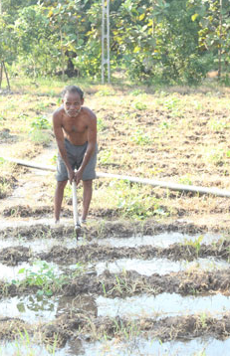
Tribals
HD for all
Acts
1996: Panchayat’s extension to Scheduled Areas (PESA) act.
2006: Forest Rights Act- 1) forest dwellers given land titles for agriculture 2) Gram Sabha on forest resources management.
Schemes
1974: 5th FYP: Tribal Sub Plan, but So many years, so many schemes. ☹ So inspired from Gujarat model [CM’s 10pt program.]
2014: Van Bandhu Kalyan Yojana @Union
Convergence of existing schemes → outcomes. [Bi-Pa-Sa-Si-Sw[+]-$-Cult]
[+]Special focus on sickle cell anemia.
Core of the core scheme, 500 cr: strengthening state dept, financing NGO projects, organize fairs. Etc.

Slide 41
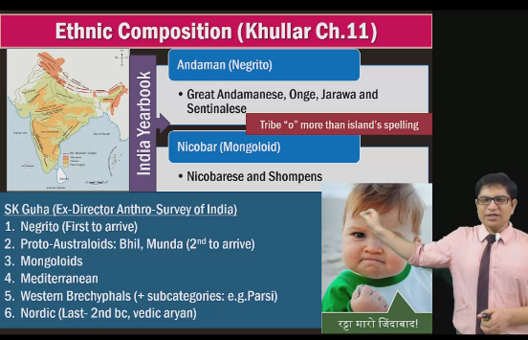
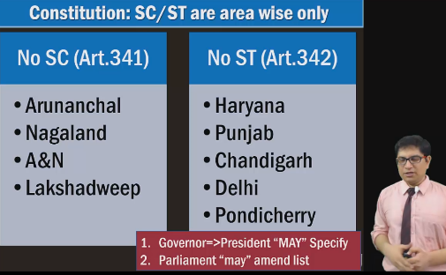
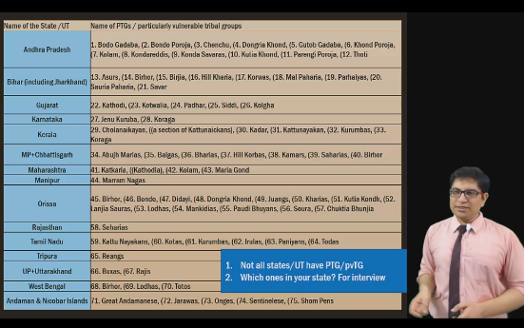
Self study BES16: CENSUS & Demography→ Scheduled Tribes link

Slide 42
UNDP HDR-2016: 5 indexes
HDI: 131/188
HDI-inequality adj. (IHDI)
Gender Dev. (GDI)
Poverty Multidim. (MPI)
Gender Inequality (GII)
Health, Education, PH, Tribal related
rank: 97/151
27% loss to HDI by inequality
Female/Male HDI
=group 1 to 5
India in 5th group [most bogus gr.]
Schemes for Women
Poverty, Hunger schemes
Notes:
Human Development Index (HDI)
the Inequality-Adjusted Human Development Index (IHDI)
Gender Development Index (GDI)
Gender Inequality Index (GII)
Multidimensional Poverty Index (MPI)

Slide 43
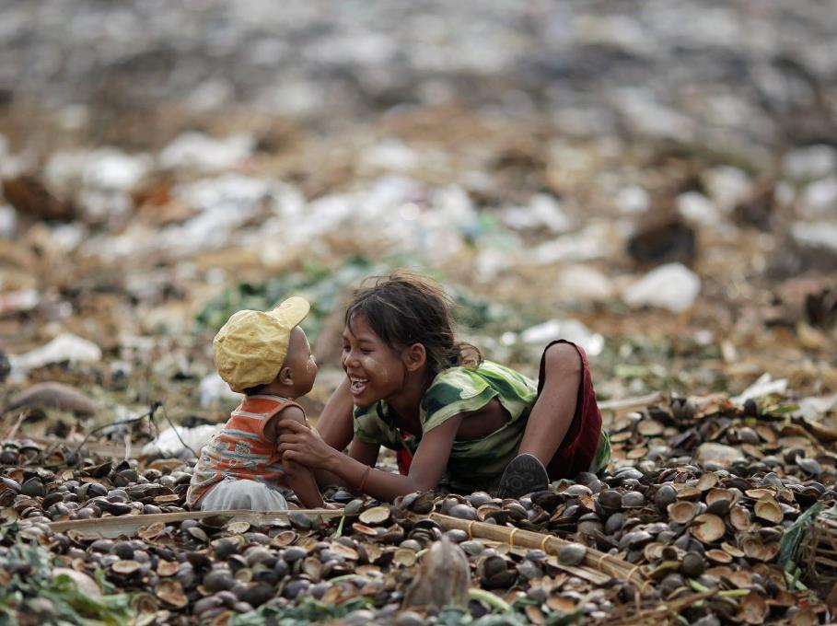
Indicator#4: Gender Inequality index (GII), since 2010
1st Switz; India 125th ;
159th YEMEN; Pak 2nd last
If Pak is 2nd most bogus, then how are they ahead in Happiness Index than India!??
GII for India
Reproductive Health
M.M.Rate: 174/1 lakh live birth
Adolescent Birth rate (15-19): 24.5/1000
Empowerment vs MEN
Parliament seats: 12.2%
Atleast HSC: 35.3%
Economic Activity
Labor force participation: 26.8%
School, college, IIT, IIM ☺
School dropout
Child marriage
MMR ☹
PM MBT 6k if only >19 age mother.
Notes:
Labour force participation rate: Percentage of
a country’s working-age population that engages
actively in the labour market, either by working or
looking for work. It provides an indication of the
relative size of the supply of labour available to
engage in the production of goods and services.

Slide 44
Sex ratio: Beti Bachao, Beti Padhaao
1994: Pre-Conception and Pre-Natal Diagnostic Techniques (PCPNDT) Act
2015: Target 100 lowest child sex ratio district
MWCD: BBBP. Improve child sex ratio to 950/1000.
[convergence with HRD, Health Ministries]
prevent infanticide, education, nutrition etc.
Mass Communication, Awareness, award <more here>
Sukanya Samriddhi FD scheme is separate thing (Fin.Inclusion #1 lecture)
New budget BBBP: 200 cr.
All India: 943/1000
Kerala 1084, TN, AP | Pudu (1037)
Haryana: 879 | D&D (618)
All India
(0-6) age girls / 1000 boys
All India 918 (census’11) | Constant negative since ’71
Child sex ratio
=(total female/total male) x 1000
Highest: Arunanchal (972)| A&N (968)
Lowest: Haryana (832)| Delhi (871)

Slide 45
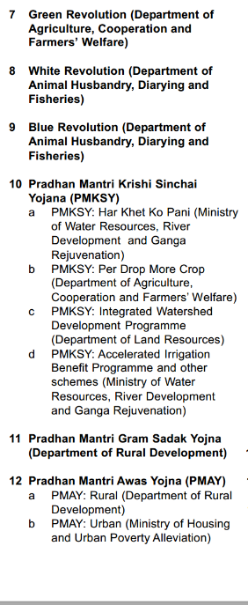
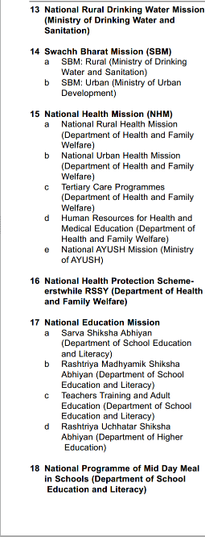
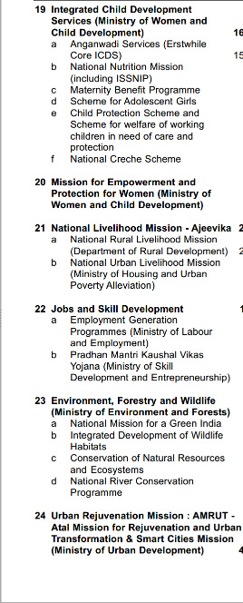
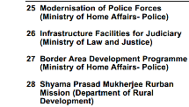
CSS: 28 schemes-6 core of the core= 22 “CORE” Schemes
Type
Core of the core
Core
Schemes
06
Special
22
General
Existing
Existing
90-10
60-40

Slide 46
Women: major schemes by MWCD
SABLA “2010
Rajiv Gandhi Scheme for Empowerment of Adolescent Girls- Age 11-18
Priyadarshini
Mid Gangetic Plains of UP+Bihar
Empowerment and Livelihood Programme in
STEP
Support to training and employment program
Nutrition, non-nutrition
Sneh Shibir
Malnutrition among women in worst districts.
2016, MANEKA GANDHI tells RS: Closed in 2015 itself, because No work done on ground. ☺
For boys=> Saksham (is it running or gone?)
Malnutrition
livelihood

Slide 47
Women: major schemes by MWCD
Swadhar Scheme ('01)
women in difficult circumstances and without any family, social and economic support
widows, disaster, jail-release etc. 300+ homes, 8k beneficiaries
Ujjawala ('09)
trafficked women (MWCD)
Ujjawal”A”
LPG in name of BPL woman (Petrol Min)
Rashtriya Mahila Kosh (RMK)
WMCD=> Micro-finance to NGO=> SHG. Not direct lending.
Nirbhaya Fund 2013
Non-lapsable fund to finance women safety projects → “one stop” SAKHI centres in 2015.
Poorna Shakti Kendra
Coordination => women can seek help of various programs/schemes.
2015: SAKHI 1 stop centre !?
2017: Mahila Shakti Kendra @ICDS !?
2 funds
2 shelters
Notes:
Working women hostel

Slide 48
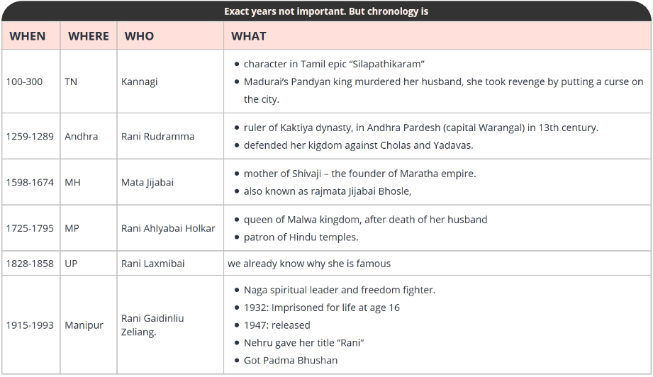
MWCD: Stree Shakti Puraskar: 6 x 3 lakhs
Notes:
‘
of social development, the government has instituted six national awards known as ‘Stree Shakti Puraskar’. These awards carrying a cash prize of ₹ 3 lakh
Devi Ahilya Bai Holkar, Kannagi, Mata Jijabai, Rani Gaidenliou Zeliang, Rani Lakshmi Bai and Rani Rudramma Devi.

Slide 49
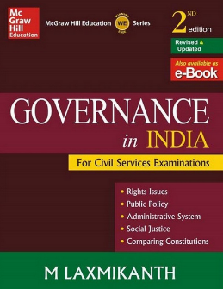
women and children
Women
90-91: National Commission for Women (NCW) statutory
Children
06-07: National Commission for Protection of Child Rights (0-18), Statutory
1995: Beijing Declaration of UN
2016: DRAFT new policy for women
Roughly based on Pam Rajput Committee,
Central Adoption Resource Authority (CARA), Statutory, CARINGS portal.
Khoya Paya portal: Missing Children [MWCD + DeitY ], 2015
2015: Domestic Violence Protection Act
2012: Protection of Children from Sexual Offences: POCSO Act: [E-box]-> national commission, MWCD.
Krishi Sakhi: last mile extension workers- similar to ASHA health worker.
Now again Draft Policy 2017 for approval.
1098: Child helpline [not for exam, but for actual use]
GSM2: Bodies
“contemporary issues”
‘79: MTP abortion upto 20 weeks. But for rape victims HC even permit higher upto 24 weeks
‘15: JJ: 16-18 “rapist, killers” as ‘adult’ WEF 2016
Triple Talaq

Slide 50
Mock Question for Prelims
Find correct pairs
1972’s Stockholm Declaration: Human environment
1995’s Beijing Declaration: Rights of women and children.
2013’s Minamata Declaration: toxic metals.
Answer choices:
a) Only 1 and 2 (b) Only 2 and 3
c) Only 1 and 3 (d) all of them
Hint: NIOS environment PDF

Slide 51
Which of the following is / are statutory bodies?
All India Council For Technical Education (AICTE)
Chief Commissioner for the persons with disability.
Central Adoption Resource Authority (CARA)
All of the above.

Slide 52
UNDP HDR-2016: 5 indexes
HDI: 131/188
HDI-inequality adj. (IHDI)
Gender Dev. (GDI)
Poverty Multidim. (MPI)
Gender Inequality (GII) 125/159
Health, Education, PH, Tribal related
rank: 97/151
27% loss to HDI by inequality
Female/Male HDI
=group 1 to 5
India in 5th group [most bogus gr.]
Next video will be last video in the BES17 series.
Schemes for Women
Poverty, Hunger schemes
Notes:
Human Development Index (HDI)
the Inequality-Adjusted Human Development Index (IHDI)
Gender Development Index (GDI)
Gender Inequality Index (GII)
Multidimensional Poverty Index (MPI)

